Slide 1
California’s Hub and Spoke System Learning Collaborative Q5
Building Your Multidisciplinary Team
Gloria Miele, Ph.D., Learning Collaborative Coordinator
UCLA Integrated Substance Abuse Programs (ISAP)
Katie Bell, MSN, RN-BC Chapa-De Indian Health

Slide 2
Agenda
Welcome, introductions
Practice Building Activity
Presentation – Katie Bell, MSN, RN-BC
QI reporting and PDSA – Acadia SD and Tarzana Treatment Center
Action planning – what’s next, upcoming events, resources

Slide 3
Learning objectives
Specify three (3) best practices to create a multidisciplinary team to treat opioid use disorders (OUD).
Describe two (2) strategies to increase retention of patients on medications for addiction treatment (MAT).
Demonstrate two (2) lessons learned about network building from the practice presentation.
Identify at least two (2) areas of improvement based on review of quality improvement (QI) measures.

Slide 4
What are Your Challenges?
MAT Team
Referral Process
Admission Process
Starting treatment
Data management
Clinic processes
Patient characteristics

Slide 5
Go Vote

Slide 6
Medication-Assisted Treatment
Meeting the opioid epidemic in our busy primary care clinics
Improving access, providing best care
Katie Bell, MSN, RN-BC Chapa-De Indian Health
Friday, November 16th, 2018
San Diego, CA

Slide 7
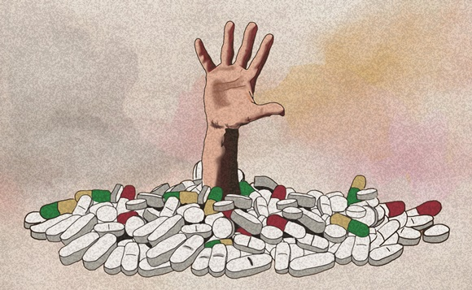
Considerations for Effective MAT Treatment
Multi-disciplinary teamwork
Systems nuts and bolts
Patient Stabilization and Retention
Harm reduction vs. Abstinence-directed
Diversion
Co-occurring BH and SUD
Perinatal
HCV
Homelessness

Slide 8
Stigma often found within the walls of care
Stigma is defined as “… a mark of disgrace associated with a particular circumstance, quality, or person.”
Involves negative judgement, misunderstanding, hostile emotions and incomplete information.
Expressed by language, body language and tone.
12 Step culture - Medication-Assisted
Treatment not considered “clean and sober”
Notes:
Kelly, j. 2016 Toward Addiction-ary: Language, Stigma, treatment and Policy, National Association of Drug Court Professionals

Slide 9
Clinic Support and Clinic Culture
Administration
Medical Reception
Call Center
Medical Records
Billing and Fiscal
Dental
Take the time to educate the ancillary departments, answer questions, give support to those who might be dealing with disclosed Substance Use in their families. Encourage learning about the MAT program. Give clear information on how MAT impacts their day to-day work.

Slide 10
Our MAT Teams
Multi-disciplinary, integrated care
Medical
Waivered providers
RN Case Managers
Medical Assistants
Behavioral Health
LMFT
LCSW
SUD
CATC
CAADC I, II
LADC

Slide 11
Multi-disciplinary teamwork
Once patient is screened for admission to MAT program ALWAYS begin with medical stabilization. This is one of the most common mistakes in clinics. If Substance Use Counselor or Behavioral Health Counselor does first intake assessment and initiates care then medical needs might not be effectively identified and treated. Patient will need a Medical admission with the MAT provider. Admission will include routine blood labs plus HCV and HIV. Patient will need starting of buprenorphine, monitoring for craving and withdrawal and finding stable dose before initiating SUD care and Behavioral Health Care.

Slide 12
Multi-disciplinary collaboration - who does what on the MAT team?
Define procedures for each discipline in MAT policies and procedures
Understand disciplines: licensing, certification, special training and scope of practice
Make best use of team talents and respect each role
Communication is essential, especially as MAT caseload increases

Slide 13
Program Manager/Coordinator
Keeps the program moving smoothly – chief problem solver
Executes the great ideas coming from the MAT team
Keeps all MAT team members in the loop of new projects, changes in procedures, community outreach
Works with MAT team and Administration – clear communication
Develops Policies and Procedures with the team

Slide 14
Weekly Case Reviews are Invaluable
Challenge is finding the time – build into provider’s schedule or lunch break
MAT Team meets to review patient current needs.
MAT decision making – such as progressing to higher Phase
Collaborative Care is MAT Gold

Slide 15
Models of Care
A model of care is often defined by available staff and provider preferences. Determining the best model of care then gives shape and direction to how the program is built. A model of care clarifies roles and areas of care. Model of care is a core element of MAT Policies and Procedures.
Notes:
Chou,R. et al Agency for Healthcare Resaerch and Quality 2016 https://www.ncbi.nlm.nih.gov/books/NBK402343/

Slide 16
RN Case Management
Complete Nursing Assessment, schedule with MD for Medical admission + labs and buprenorphine start planning. Protects and makes best use of provider time.
Keeps provider in loop as patient moves through induction phase and stabilization phase. Notifies provider of changes in cravings, side effects schedules appointments for provider
Manages refill orders with provider. Manages refill rosters.
Follows up on other needs – poor sleep, anxiety, depression, side effects
Makes referrals and works closely with BH and SUD
Weekly Case reviews
Notes:
Lobelle, C. et al Boston Medical Center Policy and Procedure Manual
https://www.bmcobat.org/resources/

Slide 17
Provider/Medical Assistant model
Medication Assisted Treatment patients scheduled for weekly or bi-weekly or monthly individual provider visits. For example, Monday morning 9 am -12 for a MAT clinic.
Medical Assistant manages flow of patients, UDS and scheduling follow-ups.
Treatment needs are referred to outside recovery service providers or internal providers.
Provider manages most of the care.
Notes:
https://www.asam.org/docs/default-source/public-policy-statements/statement-on-regulation-of-obot.pdf?sfvrsn=df8540c2_2

Slide 18
SUD counselor Case Manager
If no RN case manager, a SUD counselor can manage appropriate pathway of care – after initial screening, hands off to provider and MA for medical stabilization
Manages Treatment Agreement/ treatment planning
Individual SUD counseling and referrals to appropriate level of care
Manages and teaches MAT Refill/Stabilization Group
Manages Hub & Spoke recordkeeping

Slide 19
Behavioral Health Case Manager (because BH staff are billable – this is not best option)
Oversees management of patient care for smooth hand off of new patients to medical care and medical stabilization
Develops treatment plan with MAT and patient
Provides referrals and interventions for changes in level of care as appropriate
Leads MAT refill/stabilization group and other MAT groups
Identify patient readiness for therapy or skills building program

Slide 20
Where to Start
Designating and scheduling Provider time for individual MAT appointments and for Group time is best way to start MAT program

Slide 21
Nuts & Bolts of Systems of Care
Provider schedules
Patient flow
Billing
Hub & Spoke spreadsheets, tracking monthly report and monthly invoicing
Data Management– what to measure, how to measure
Patient Tracking – every team needs a good roster

Slide 22
Our patients

Slide 23
Low-Threshold Access to Care in Primary Care Setting
Difficulty keeping appointments
High acuity – co-occurring mental health diagnosis, co-occurring severe SUD
Labor intensive – connection with services can be challenging
Case management needs – often need homes, incomes, vehicles, jobs, reuniting with children
Notes:
Stancliff,s., et al Aspects of Recovery from Addiction 2012
https://www.tandfonline.com/doi/ref/10.1080/10550887.2012.694603?

Slide 24
Trauma-Informed Care
First MAT intake should include Adverse Childhood Experiences (ACEs) screen.
"Rather than ask, ‘ why the addiction?’ ask ‘why the pain?’ ” – Gabor Mate MD
Notes:
Brous, K. 2014 https://www.acesconnection.com/blog/dr-vincent-felitti-the-origins-of-addiction-evidence-from-the-adverse-childhood-experiences-study

Slide 25
Return to the Felt Experience of Life
Buprenorphine, the partial agonist, allows for emotions and sensations where the full-agonist opioid blunts and numbs feeling.
It is essential that the clinical team understands our patients with trauma may find the experience of “tingling to life” to be distressing and overwhelming. If there is significant Post Traumatic Stress, provide care for this early stabilization process with information, validation and developing self-regulating strategies.

Slide 26
A Pathway of Care
Screening and referral
The essentials to stabilization with suboxone
Importance of assessment
Starting Buprenorphine (induction)
Right dose of medication
Treatment Agreement with Treatment Plan
Education and Support

Slide 27
A Pathway of Care (continued)
Level of Care per ASAM criteria
Case Management –refers based on LOC
Clear expectations
Phases of Care
Refill/Stabilization Groups
Notes:
Lobelle, C. 2016 Boston Medical Center Policies and Procedures OBOT

Slide 28
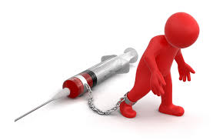
Care of Patient comes first…
…admission process and paperwork can wait.
Helping the patient to STOP USING takes priority. If patient is enrolled in clinic as patient then get them started with suboxone with up to 3 day supply (usually 16 mg X 3 days). This will give you time to schedule MD admission appointment, nursing intake and treatment agreement, ROI, etc.
If patient is new patient see if you can fit them in for New Patient appointment asap with start of suboxone as part of initial visit.

Slide 29
Screening and Referrals to MAT
Screening – new patient intake and routine visits.
One or two question screen about opioid use at new patient visits or annual check-ups
Self-referral – often word of mouth as user groups begin to seek help one by one and become recovery groups

Slide 30
MAT Assessment/Intake Nursing Assessment prior to induction and MAT program admission
Current Opioid and other Substance use
History of substance use and periods of abstinence
Medical Hx
Psych Hx including Adverse Childhood
Release of Information
Experiences (ACEs) screen and adult trauma hx
Social history and current support
Legal – hx and current
Alcohol and Drug Treatment hx
Patient preferences explored
ASAM criteria
CURES

Slide 31
MAT Medical Admission
Provider visit
If new patient, then new patient visit
If already a patient with clinic then medical clearance
Routine labs plus HCV and HIV (required by CA H & S SS)
Notes:
Providers Clinical Support System https://30qkon2g8eif8wrj03zeh041-wpengine.netdna-ssl.com/wp-content/uploads/2014/10/Sample-1-Treatment-Agreement.pdf

Slide 32
Induction/Starting Buprenorphine
Purpose: stop resumption of opioid use by relieving cravings and opioid withdrawal as quickly and as effectively as possible.
Prepare patient with clear instructions and comfort medications for required withdrawal phase.
Notes:
ASAM Guidelines 2015https://www.asam.org/docs/default-source/practice-support/guidelines-and-consensus-docs/asam-national-practice-guideline-supplement.pdf

Slide 33
Home or Non-Clinic Starts
Home Inductions – evaluate patient’s prior experience with suboxone and prior experience with precipitated withdrawal.
Give clear written instructions and comfort medications for the brief
For most heroin users or opioid medication MME > 100 mg, Buprenorphine/naloxone 24/6 mg in first 24 hours will give us a sense of patient’s tolerance of buprenorphine and of any side effects. With 24 mg on board on the morning of Induction Day 2, then provider will know how to proceed with induction. Important: measure craving.
If patient is also a meth user than expect the sedation side effect of bup to cause the ‘crash’ of stimulant withdrawal – days of sleeping.
Notes:
Lee,J., et al, Journalof Internal Med 2009 https://www.ncbi.nlm.nih.gov/pmc/articles/PMC2628995/

Slide 34
In-Clinic Starts
If patient has no reported experience with Suboxone (prescribed or non-prescribed).
Methadone to buprenorphine
Highest risk for precipitated withdrawal
Pregnancy (may be done in hospital depending on trimester)
Notes:
Casadonte, P. 2013 Providers Clinical Support System https://pcssnow.org/wp-content/uploads/2014/03/PCSS-MATGuidanceTransferMethadonetoBup.Casadonte.pdf

Slide 35
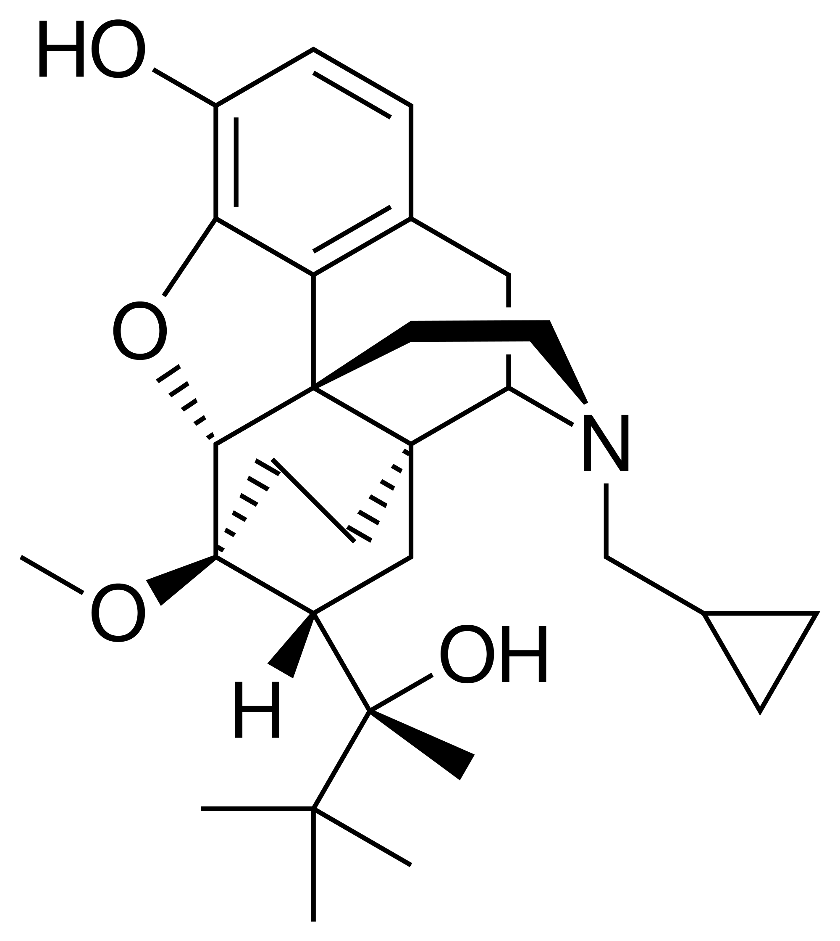
Dose stabilization
Finding a stable dose, “the sweet spot” of no cravings, no withdrawal and no or minimum side effects usually by Day 14.
If there are challenges to finding a stable dose, consider that patient may be self-managing their dose. This is a not an uncommon behavior.
Notes:
SAMHSA – Buprenorphine Stabilization Phase. https://www.samhsa.gov/medication-assisted-treatment/treatment/buprenorphine

Slide 36
Treatment Agreement
Treatment Agreement includes Treatment Plan:
Example: Phase 1(weekly group, UDS, Rx) + Behavior Health Biopsychosocial + Outpatient Treatment at local provider
KEEP IT SIMPLE and Do-able
Education and Support
Patient-centered case management
Notes:
Providers Clinical Support System https://30qkon2g8eif8wrj03zeh041-wpengine.netdna-ssl.com/wp-content/uploads/2014/10/Sample-1-Treatment-Agreement.pdf

Slide 37
Phases of Care Phase 1
Harm Reduction and Abstinence-Directed
Weekly MAT group ( also known as refill/stabilization groups)
7 day suboxone Rx ( with refills, if appropriate and for clinic convenience
Weekly Point of Care Urine Drug Screens
Behavioral Health Biopsychosocial assessment with appropriate referrals for therapy and psychiatry within 30 days. Patients with immediate needs for continued medications and referral to psychiatry will be identified in Nursing Assessment And Medical Admission appointment.
Notes:
enter for Substance Abuse Treatment. Medication-Assisted Treatment for Opioid Addiction in Opioid Treatment Programs. Rockville (MD): Substance Abuse and Mental Health Services Administration (US); 2005. (Treatment Improvement Protocol (TIP) Series, No. 43.) Chapter 7. Phases of Treatment. Available from: https://www.ncbi.nlm.nih.gov/books/NBK64172/
Rationale for Phased Treatment Approach and Duration https://www.ncbi.nlm.nih.gov/books/NBK64172/#A83029

Slide 38
Phases of Care Phase 2
Patient-centered decision made by the MAT Team
Patient has adhered to all requirements of their Phase 1 Treatment Plan
Meet with patient to update Treatment Agreement and Phase 2 expectations
14 day Suboxone Rx
14 day Urine Drug Screen
Bi-weekly attendance at MAT Refill/Stabilization Group

Slide 39
Phases of Care Phase 3
30 day Rx ( or 28 day to keep pick-up days consistent throughout Phases)
One required Counseling visit – individual or group
Monthly UDS
MD visit every 90 days minimally, some patients prefer monthly visits
If relapse then increase care, patient returns to Phase 1 or Phase 2 per MAT team decision for more care and stabilization.

Slide 40
Why urine drug screen?
UDS with every group or MD visit –
Consistency helps your patients to expect to submit UDS
determined by Phase expectations
How are patients doing? - other drugs on board?
POC UDS must be confirmed before taking action.
Non-threatening and supportive – never legalistic.
Focus on medical rationales and recovery principles.
Notes:
Miller, K. et al Urine Drug Testing Results 2017 https://www.journalofsubstanceabusetreatment.com/article/S0740-5472(16)30427-5/abstract

Slide 41
Urine Drug Screens
In the medical setting, we avoid use of street language.
A lab result is NEVER clean or dirty.
The results are discussed as positive or negative.

Slide 42
MAT Refill/Stabilization Groups
A weekly group which is also a provider visit is
an effective way to;
provide 7 day or 14 day suboxone refills
to gather updated patient self-report
collect a urine drug screen
education and recovery tools
Provide individual MD time
MAT team indiv interventions

Slide 43
MAT Refill/stabilization Group
Sample Format: brief segments work for patients new to treatment with short attention span. Quotes and values on whiteboard.
Mindfulness – 5 minutes
Group rules
Check-in –offer a topic “What did you savor and enjoy this past week”
Education – 10 minutes – “Getting to Know Your Autonomic Nervous System: Fight/Flight/Freeze and Rest/Digest”
Recovery Tools – 35 minutes “The Return to Feelings”
Check-out – your wellness plans for the coming week

Slide 44
Behavioral Health Care
Biopsychosocial intake using routine screening tools for BH intake
PHQ -9 Depression, GAD -7 Anxiety, Social Development History
BH Treatment planning
Biofeedback. CBT. DBT. ACT.
Referral to psychiatry or PCP for evaluation for psych medication

Slide 45
Recovery
Cultural Traditions
Restoration of wellness
Healers and Artists
Dreams and Values
Behavioral Health
Life Directions
Restored Relationships

Slide 46
Other Substance Use: Alcohol
Important to assess for alcohol history during first assessment.
Alcohol rehabs? DUIs? History of heavy use? Still drinking? How much? Last drink?
Prescribing Suboxone while heavy drinking – is it safe?
Alternative Care includes Antabuse and the Vivitrol option. Remember the transfer from Suboxone to Vivitrol requires: 1. withdrawal from Buprenorphine 2. Naltrexone by mouth 3. Start Vivitrol. This can take 2 -3 weeks.
Antabuse works best with supportive person administering daily
Notes:
Nolan,S.et al Alcohol in Opioid Agonist Treatment
Addict Sci Clin Pract. 2016; 11: 17.
https://www.ncbi.nlm.nih.gov/pmc/articles/PMC5146864/

Slide 47
Other Substance Use: Methamphetamine
The most common other substance among heroin users
Fentanyl-laced meth – test strips
Phase 1 – harm reduction
Level of Care – if continued use, refer to HUB for daily dosing or Residential for detox and stabilization
Best interventions for meth users – all POS UDS will be discussed with patient with motivational interviewing and change strategies
Notes:
Salehi, M. 2015 The Effects of Buprenorphine on Methamphetamine Cravings J of Clinc Psychopharmacology
https://www.ncbi.nlm.nih.gov/pubmed/26468683

Slide 48
Perinatal Care
Pregnancy – Subutex standard of care. Induction risk is withdrawal stress causing pre-term labor.
Neonatal Abstinence Syndrome - prepare mother; work with NICU
Best practices: swaddling, rooming in, skin to skin, quiet environment, breastfeeding
Post-partum – increase care, assess for post-partum depression; nurse home visits are ideal
Notes:
Clinical Guidance for Treating Pregnant and Parenting Women With Opioid Use Disorder and Their Infants 2018 https://store.samhsa.gov/shin/content//SMA18-5054c/SMA18-5054.pdf

Slide 49
SAMHSA Healthy Mother, Healthy Baby
SAMHSA – 16 Fact Sheets for Mothers with opioid use disorder.
Link to order or download

Slide 50
Tapering off of Suboxone
Patient-centered decision
Discuss reasons for tapering and educate risks for relapse
Write up a taper plan
Slow taper, weekly monitoring
BuTrans patch (weekly) off-label for OUD. For pain Management. These Dx often intersect. 20 mcg/h – 5 mcg/h, can go slowly with BuTrans

Slide 51
Tapering (cont’d)
Consider low-dose gabapentin, clonidine when Buprenorphine dose goes lower than 2 mg
As patient tapers off monitor for:
Cravings for opioids
dysphoria, insomnia, increased anxiety – treat symptomatically
Consider Naltrexone PO – start 1 week after last dose of buprenorphine

Slide 52
Discharge
Safety
Individual safety
Heavy Alcohol Use and Heavy non-prescribed benzo use
Continued Opioid Use while taking suboxone
Unwillingness to go to Recommended Level of Care with continued use
Public Safety
Diversion
ALWAYS OFFER HIGHER LEVEL OF CARE TO PATIENT ENGAGING IN UNSAFE USE OR BEHAVIORS

Slide 53
Sustainability
Grants - Managing requirements can be labor intensive
Utilizing non-billable team and billable provider visits
Provider Group Visits
Flip visits
California Health Care Foundation is publishing a guide to billing for MAT in Primary Care - coming soon

Slide 54
Chronic Pain, Safe Prescribing and Buprenorphine for Pain Management
Evaluate patient for safe opioid dosing – combined with Benzos, Z-drugs, Soma, other opioids?
Evaluate for pain levels and quality of life
Assess for Opioid Induced Hyperalgesia
Needing more opioids and getting less relief. Increased sensitivity to all pain.
Assess for Opioid Use Disorder – mild - moderate – severe
Assess for Behavioral Health needs

Slide 55
Chronic Pain, Safe Prescribing and Buprenorphine for Pain Management (cont’d)
Assess for other substances
When a long-term opioid therapy is decreased, the patient may begin to increase or add alcohol consumption to manage pain or sleep.
Consider Buprenorphine for pain management.
If patient wants to come off of all opioids safely with well-managed withdrawal, consider buprenorphine for best way to manage withdrawal.

Slide 56
Venn Diagram
Opioid Use Disorder (OUD)
Medication Assisted Treatment
Safe Rx
Pain with NO OUD or other substances
Pain w OUD /other substances
BUP for Pain

Slide 57
Other issues
Trauma informed care
Cultural traditions
Behavioral health
Other substance use
Pregnancy
Tapering
Discharge

Slide 58
Comic

Slide 59
Self-Care and Balance –follow your bliss

Slide 60
Sevent Types of Ordinary Happiness

Slide 61
Handouts
Preparation for in-clinic or non-clinic Starting of buprenorphine
MAT Group and Individual Check-in sheet
MAT Group Rules - laminated
Roster - example

Slide 62
NEXT STEPS
Next quarterly LC session
Feb/March 2019 in person
Cases for ECHO Clinics
Dec 3, 2018, then 4th Monday 2019
Stimulants and MAT Webinar
Dec 6, 2018
Prescriber facilitator program
Other trainings – what are your needs?

Slide 63
References 1
Addict Sci Clin Pract. 2016; 11: 17. Retrieved from: Alcohol use in opioid agonist treatment
Brous, K. et al, 2014. Retrieved from: Dr. Vincent Felitti: “The Origins of Addiction: Evidence from the Adverse Childhood Experiences Study”
Casadonte, P., et al 2013 Providers Clinical Support System. Retrieved from PCSS Guidance: Transfer from Methadone to Buprenorphine
Center for Substance Abuse Treatment. Medication-Assisted Treatment for Opioid Addiction in Opioid Treatment Programs. Rockville (MD): Substance Abuse and Mental Health Services Administration (US); 2005. (Treatment Improvement Protocol (TIP) Series, No. 43.) Chapter 7. Phases of Treatment. Available from: https://www.ncbi.nlm.nih

Slide 64
References 2
Chou,R., et al, Agency for Healthcare Research and Quality 2016 https://www.ncbi.nlm.nih.gov/books/NBK402343/Chou,R. et al Agency for Healthcare Research and Quality 2016. Retrieved from: Medication-Assisted Treatment Models of Care for Opioid Use Disorder in Primary Care Settings
Clinical Guidance for Treating Pregnant and Parenting Women With Opioid Use Disorder and Their Infants 2018. Retrieved from: Clinical Guidance for Treating Pregnant and Parenting Women With Opioid Use Disorder and Their Infants
Lee, J ., et al, Journal of Internal Med 2009. Retrieved from: Home Buprenorphine/Naloxone Induction in Primary Care
Lobelle, C., C. et al Boston Medical Center Policy and Procedure Manual. Retrieved from: Office Based Addiction Treatment Training and Technical Assistance

Slide 65
References 3
Miller, K. et al, Urine Drug Testing Results 2017. Retrieved from: Urine drug testing results and paired oral fluid comparison
On Models of care: Public Policy Statement on the Regulation of Office-Based Opioid Treatment
Salehi, M., et al, 2015 The Effects of Buprenorphine on Methamphetamine Cravings J of Clinc Psychopharmacology. Retrieved from: The Effect of Buprenorphine on Methamphetamine Cravings
SAMHSA – Buprenorphine Stabilization Phase. Retrieved from: Buprenorphine
Stancliffe, S. et al Aspects of Recovery from Addiction 2012. Retrieved from: Opioid Maintenance Treatment as a Harm Reduction Tool

